Slide 1
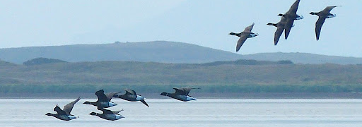
FLIGHT RESPONSE OF THE PACIFIC BRANT GRADTDA 5402 | SP25 | project 2 Dheel, Newman, Siefker
Pacific Brant in Flight (image source: http://coldbayoutfitters.com/pacific-brant-hunting-coldbay/)

Slide 2

Agenda
Background Information
Exploratory Data Analysis
Altitude vs. Flight Response
Latitude vs. Flight Response
Altitude + Latitude v. Flight Response
Recommendations
Izembek Lagoon, Alaska (image source: http://allaboutbirds.org)

Slide 3
Background information
CONCERN: Increased air traffic around Izembek Lagoon is disturbing the feeding and resting activities of Pacific brant in the area, which may reduce energy intake and result in increased mortality rates during migration.
STUDY: Investigate the flight response of brant to overflights of large helicopters at varying altitudes and lateral distances from the flocks.
DATA:
464 observations of Pacific brant flock responses to overflights (1 = flight response, 0 = no flight response)
Altitude of the helicopter - randomly assigned to 0.91, 1.52, 3.05, 4.57, 6.10, 6.71, 7.62, 9.14, 12.19 (100 meters)
Lateral distance of the helicopter from the flock (100 meters)
Notes:
Each fall, nearly 130,000 brant fly to Izembek Lagoon, Alaska to accumulate fat reserves for migration to wintering areas. In the past 10 years, air traffic in and out of nearby Cold Bay airport has increased. There is a concern that the increased air traffic could disturb the brant, resulting in reduced energy intake and buildup, which may increase mortality rates during the brants’ migration.
In response to this concern, a study was conducted to investigate the flight response of brants to overflights of large helicopters. Flight responses of flocks were measured during experimental flights of helicopters at varying altitudes and perpendicular distances from the flocks. We will use data from the study to make recommendations regarding helicopter flight paths.
Data collected from the study included...

Slide 4

Key QUESTIONS
What is the effect of helicopter altitude on the flight response of the Pacific brant?
What is the effect of helicopter lateral distance on the flight response of the Pacific brant?
What are recommendations for air traffic near flocks of Pacific brant?
Izembek National Wildlife Refuge (image source: https://ak.audubon.org/conservation/izembek-national-wildlife-refuge)

Slide 5
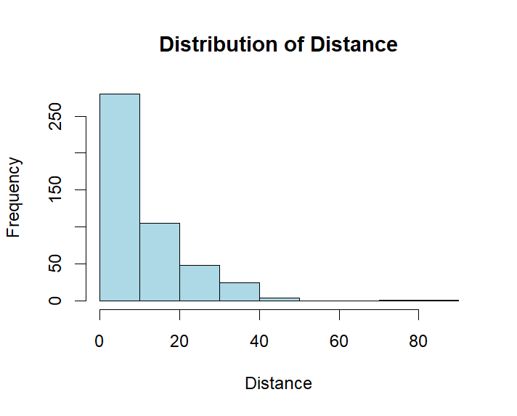
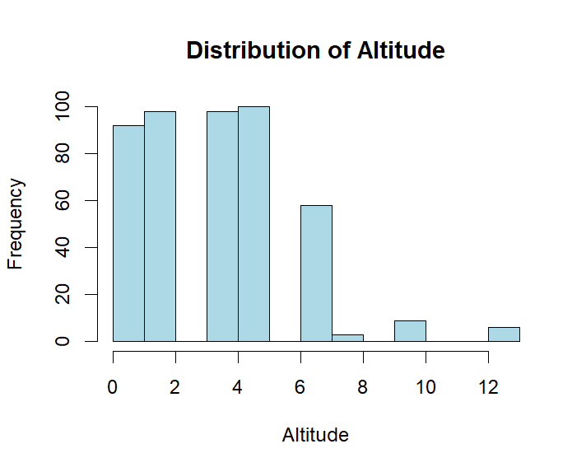
Exploratory data Analysis

Slide 6
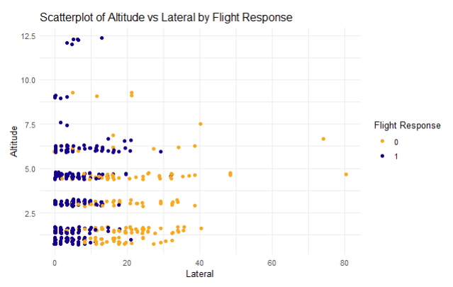
Exploratory data Analysis

Slide 7
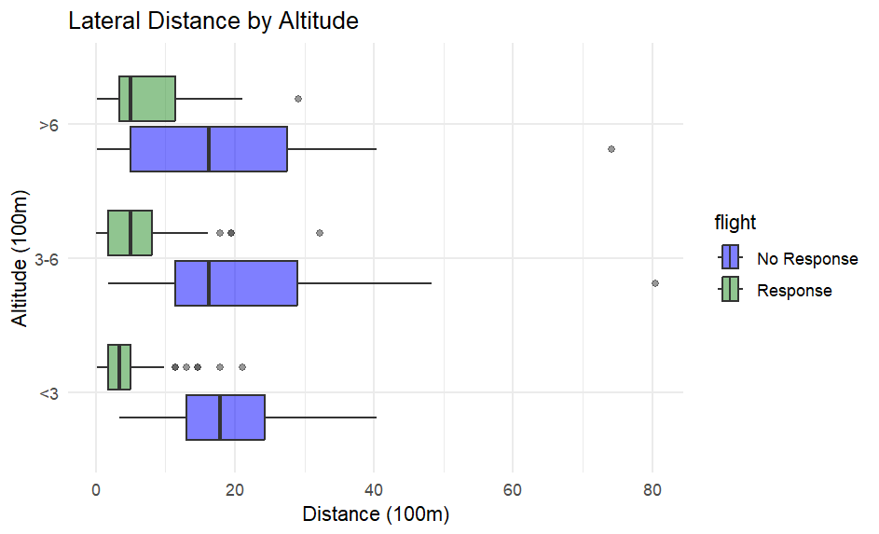
Exploratory data Analysis

Slide 8
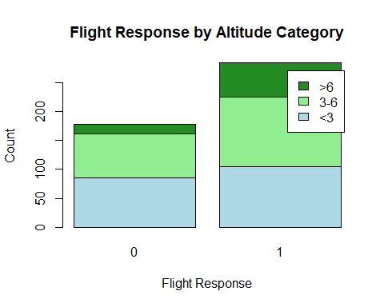
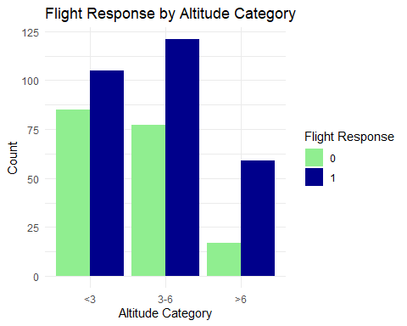

ALTITUDE Category vs. FLIGHT RESPONSE
Notes:
For analysis purposes, we classified altitude into three categories: <3, 3-6, and >6.
The plot on the left shows that, regardless of altitude, there were more flight responses than non-responses in the dataset. Both flight responses and non-responses occurred at every altitude category. At the >6 altitude category, the plot indicates that more flights had a response than did not have a response.
The plot on the right is another way to visualize flight response and non-response by altitude category. You can see that more flocks had a response than did not have a response at every altitude category.

Slide 9
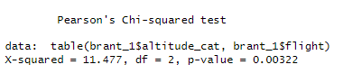
STATISTICAL ANALYSIS: ALTITUDE vs. FLIGHT RESPONSE
Chi-Squared Test: We used Pearson’s Chi-squared test to check for a significant association between the altitude categories and flight response.
H₀: There is no association between altitude category and flight response (i.e. altitude category and flight are independent)
H_{A}: There is an association between altitude category and flight response (i.e., altitude category and flight response are dependent)
Output:
Interpretation: The p-value is less than 0.05, so we reject the null hypothesis at the 5% significance level. We conclude that there is significant evidence to support the alternative hypothesis that there is strong evidence of an association between altitude category and flight response.
Notes:
We used a Chi-squared to test for a significant association between the altitude categories and flight response. A pvalue of .003 caused us to reject the null hypothesis and conclude that there is strong evidence of an association between altitude category and flight response.

Slide 10
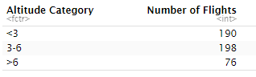
STATISTICAL ANALYSIS: ALTITUDE vs. FLIGHT RESPONSE Check Chi-squared Test assumptions
Independence: Based on the dataset description, each observation is independent.
Categorical Data: Flight altitudes were assigned to nine discrete categories. For ease of analysis, altitude was further classified into three categories.
Adequate sample size: Sample sizes seem to be sufficiently large in each category, although the categories are unbalanced.
Notes:
We checked assumptions and confirmed that the dataset meets the chi-squared assumptions of independence, categorical data and adequate sample size.

Slide 11
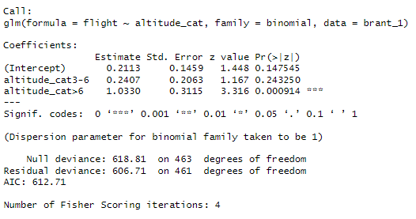
STATISTICAL ANALYSIS: ALTITUDE vs. FLIGHT RESPONSE
Logistic Regression Model: We used a logistic regression model to predict the probability of a flight response based on the altitude category.
H₀: Altitude category has no effect on flight response.
H_{A}: At least one altitude category has an effect on flight response.
Output:
Interpretation: We reject the null hypothesis and conclude that there is strong evidence that helicopters flying at an altitude greater than 600 meters have a significant effect on flight response. An altitude <300 meters does not have a significant effect of flight response., and there is no statistically difference in flight response between <300 meters and 300 – 600 meters.
Notes:
Next, we used logistic regression to predict the probability of a flight response based on the altitude category. Interestingly, this model shows that higher altitudes are more likely to create a flight response.
The altitude histogram shows that the dataset included fewer flights at altitudes > 600 meters than flights in the other categories. The unbalanced data could potentially account for this finding. Inclusion of lateral distance in the model may provide a different interpretation.

Slide 12
STATISTICAL ANALYSIS: ALTITUDE vs. FLIGHT RESPONSE Check logistic regression assumptions
Binary Outcome: The dependent variable is binary (1 = flight response, 0 = no flight response)
Independence: Based on the dataset description, each observation is independent.
No extreme outliers: Helicopters were required to fly at one of 9 prescribed altitudes; therefore, there were no extreme outliers in the altitude observations.
Large sample size: Sample sizes seem to be sufficiently large in each category, although the categories are unbalanced.
Notes:
We checked assumptions and confirmed that the dataset meets the logistic regression assumptions of binary outcome, independence, no extreme outliers, and large sample size.

Slide 13
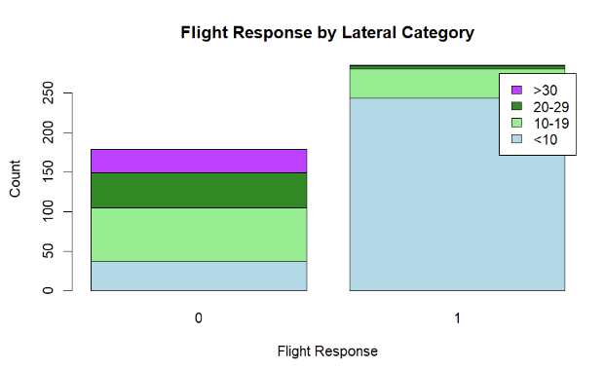
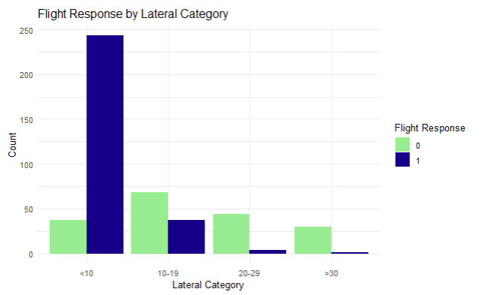
Lateral Category vs. FLIGHT RESPONSE
Notes:
Moving on to the lateral distance analysis, we classified lateral distance into 4 categories and visualized the data.
The plot on the left shows that there were significantly more flight responses when lateral distance was less than 1000 meters. Flocks that did not have a flight a response were spread fairly evenly across all lateral categories.
The plot on the right shows that a much higher number of close (<1000 m) helicopter flights caused a flight response. For all other distance categories, flight responses were more unusual. Very few flocks had a flight response when helicopters were more than 2000 m away.

Slide 14
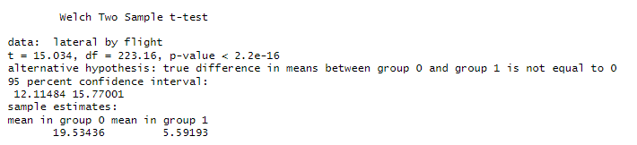
STATISTICAL ANALYSIS: Lateral Distance vs. FLIGHT RESPONSE
T-Test: We used a T-Test to determine whether the mean lateral distance differed significantly between flocks that had a flight response and flocks that did not have a flight response.
H₀: The mean lateral distance is equal for flocks that had a flight response and flocks that did not have a flight response.
H_{A}: The mean lateral distance is different for flocks that had a flight response and flocks that did not have a flight response.
Output:
Interpretation: The p-value is less than 0.05, so we reject the null hypothesis at the 5% significance level. We conclude that there is significant evidence that the mean lateral distance is significantly different in flocks that had a flight response and flocks that did not have a flight response. The mean lateral distance is greater in flocks without a flight response (about 1,900 meters) compared to flocks with a flight response (about 500 meters)
Notes:
We used a t-test to determine whether the mean lateral distance differed significantly between flocks that had a flight response and flocks that did not have a flight response.
The test provided significant evidence that the mean lateral distance is significantly different in flocks that had a flight response and flocks that did not have a flight response. The mean lateral distance is greater in flocks without a flight response (about 1,900 meters) compared to flocks with a flight response (about 500 meters).

Slide 15
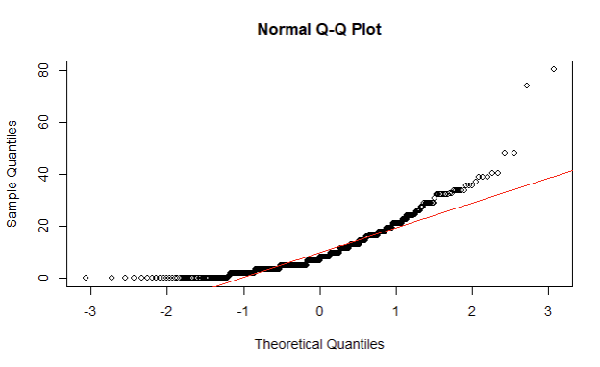
STATISTICAL ANALYSIS: Lateral Distance vs. FLIGHT RESPONSE Check T-Test assumptions
Continuous: We used the continuous lateral distances provided in the dataset, rather than the lateral distance categories.
Independence: Based on the dataset description, each observation is independent.
Approximately Normal: The QQ Plot shows some evidence of non-normality. However, Welch’s T-Test is robust to non-normality with larger sample sizes.
Notes:
We checked assumptions and confirmed that the dataset meets the logistic regression assumptions of continuous data and independence. The QQ Plot shows some evidence of non-normality. However, Welsh’s t-test is robust to non-normality with larger sample sizes.

Slide 16
Statistical Analysis: Lateral Category vs. FLIGHT RESPONSE

Slide 17
STATISTICAL ANALYSIS: Lateral Category vs. FLIGHT RESPONSE

Slide 18
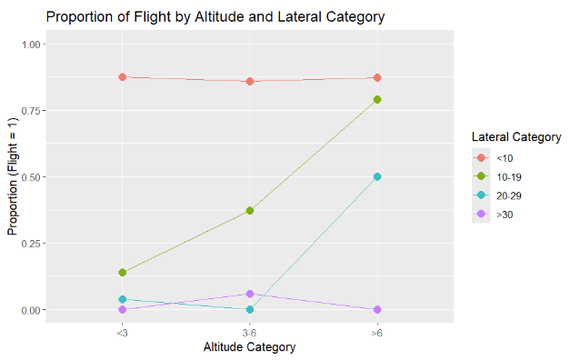
STATISTICAL ANALYSIS: Interaction Plot

Slide 19
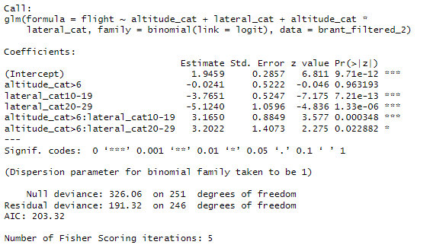
STATISTICAL ANALYSIS: FLIGHT RESPONSE + Altitude CATEGORY + LATERAL Category + INTERACTION
Multiple Logistic Regression Model: We used a multiple logistic regression model including the altitude category and lateral category as predictors. We used stepwise backward selection to select a model.
H₀: Neither altitude category, lateral category, or their interaction has an effect on flight. H_{A}: At least one of the predictors or their interaction affects flight.
Output:

Slide 20
STATISTICAL ANALYSIS: Altitude + Lateral Distance vs. FLIGHT RESPONSE
Interpretation of Multiple Logistic Regression Model Output:
The following are significant at the 5% level:
When altitude is <600 meters and lateral distance is < 1,000 meters (the reference categories in the model), the log-odds of flight is 1.9459, which means the probability of flight is about 87.5%.
When altitude is > than 600 meters, the log-odds of flight compared to < 600 meters are not significant.
When lateral distance is1,000 - 1,900 meters, the log-odds of flight compared to <1,000 meters are 3.7651 lower. Using the odds ratio, the probability of flight is 13.9%.
When lateral distance is 2,000 – 2,900 meters, the log-odds of flight compared to < 1,000 meters are 5.1240 lower. Using the odds ratio, the probability of flight is 1.4%.
An altitude > 600 meters has a significant effect on flight when the lateral distance is between 1,000 and 2,900.
Key Notes
Alone, altitude categories don’t significantly affect flight response.
Odds of flight drop significantly as lateral distance increases. Lateral distances > 2,000 meters have low flight risk at any altitude.
Altitude modifies lateral effects. Low altitude and close proximity are most likely to trigger a flight response.

Slide 21
STATISTICAL ANALYSIS: Lateral Category vs. FLIGHT RESPONSE Check Multiple Logistic Regression Model assumptions
Binary Outcome: The dependent variable is binary (1 = flight response, 0 = no flight response)
Independence: Based on the dataset description, each observation is independent. The model also assumes that the effects of altitude and lateral distance are independent of each other (no interaction). Further modeling could consider interactions between the predictors.
Predictors not highly correlated: Predictors are categorical, so this assumption is not critical.
No extreme outliers: Visual inspection of scatterplots indicated two potential outliers in the lateral distance predictor. Consider dropping those observations in further analysis.
Large sample size: Sample sizes seem to be sufficiently large in each category, although the categories are unbalanced.

Slide 22
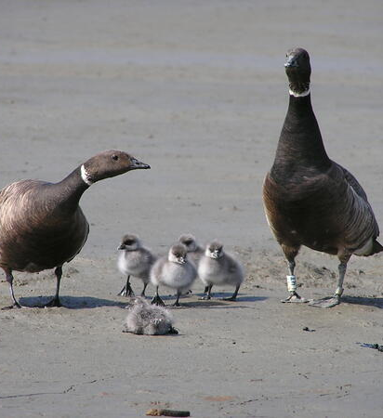
Current Requirement The current FAA minimum altitude standard for flying over Izembek Lagoon is 2,000 feet.
Recommended Requirements To minimize disruptions that cause a flight response in Pacific brant:
Keep the current minimum altitude requirement of 2,000 feet.
Add a minimum lateral distance requirement of 2,000 feet.
Pacific brant (image source: https://www.usgs.gov)

